Slide 1
Rally Health Eligibility Canonical Update
Team Mackers
Notes:
Tony

Slide 2
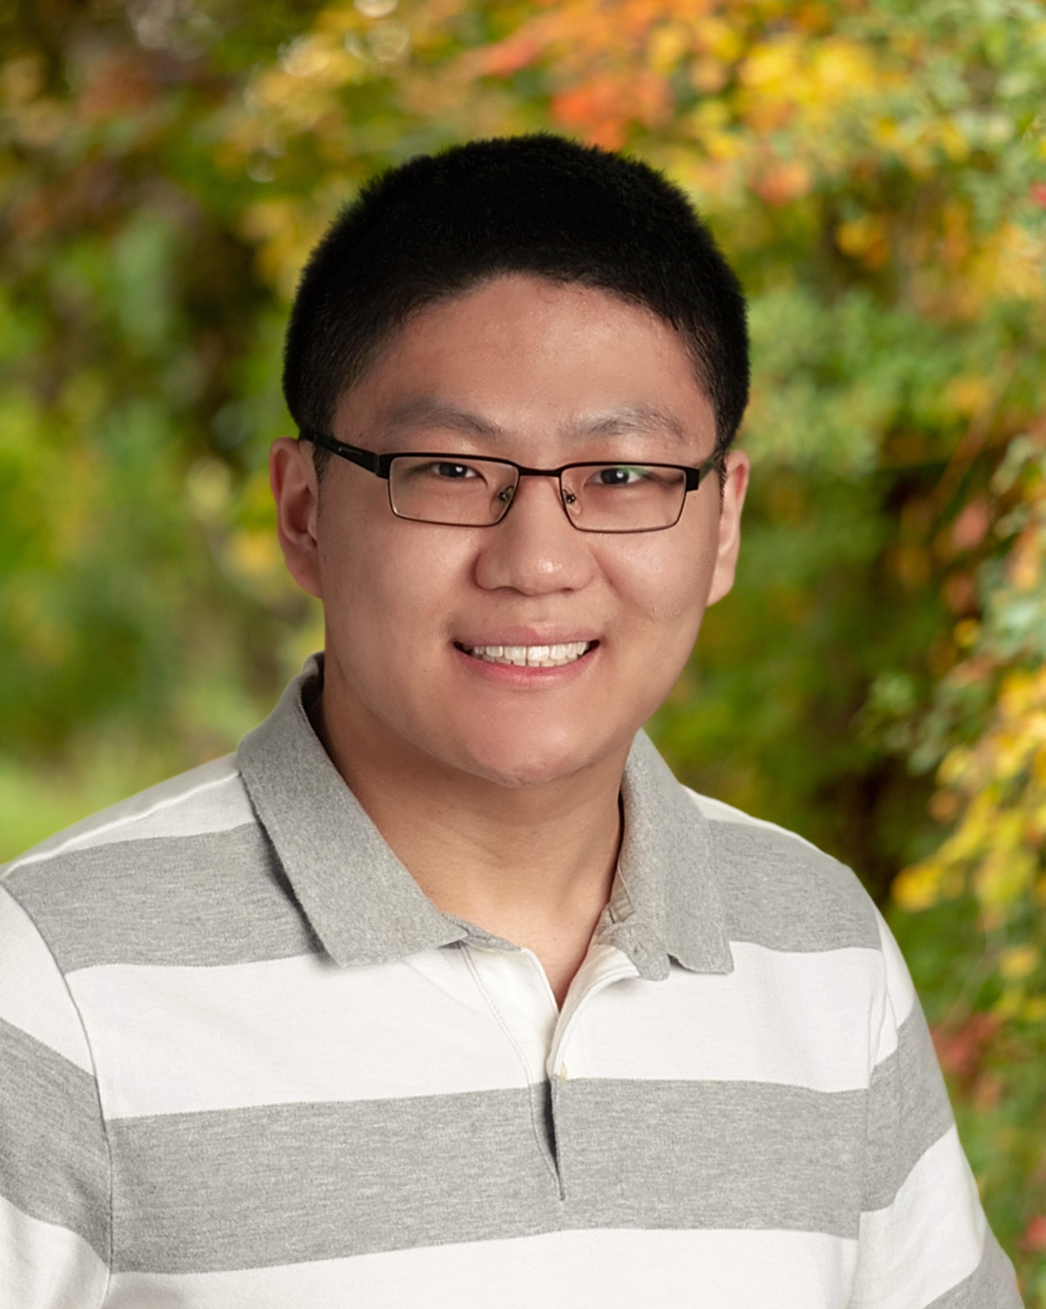
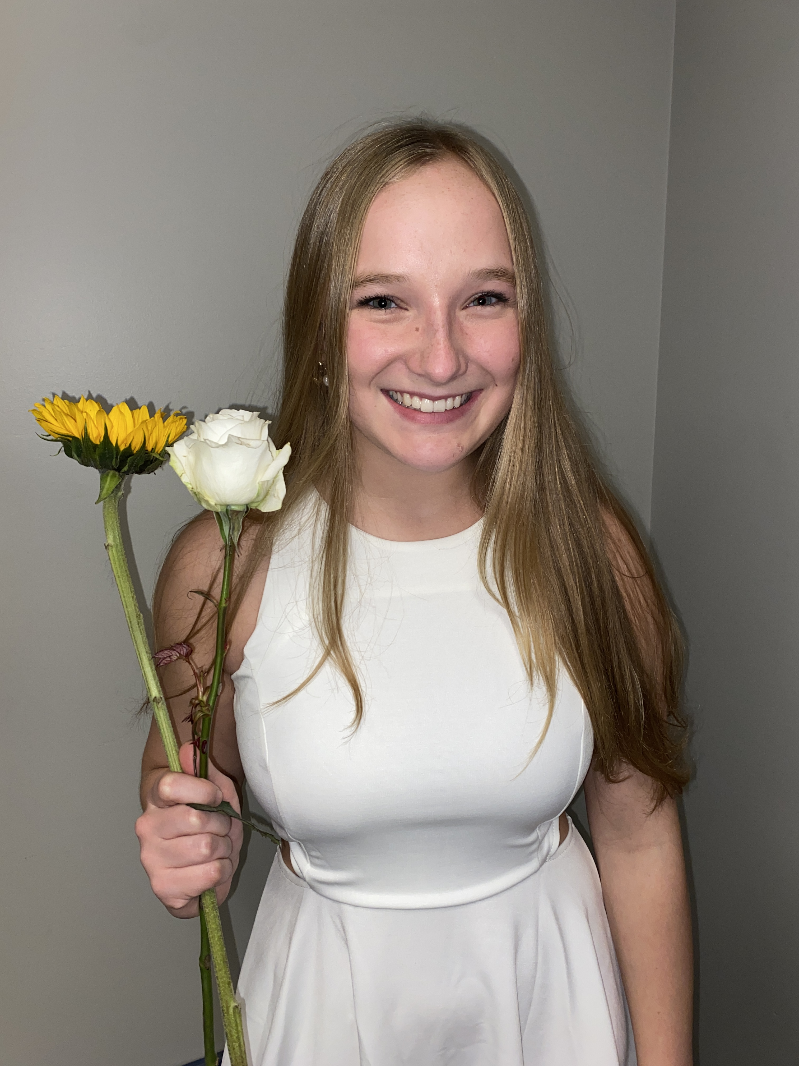

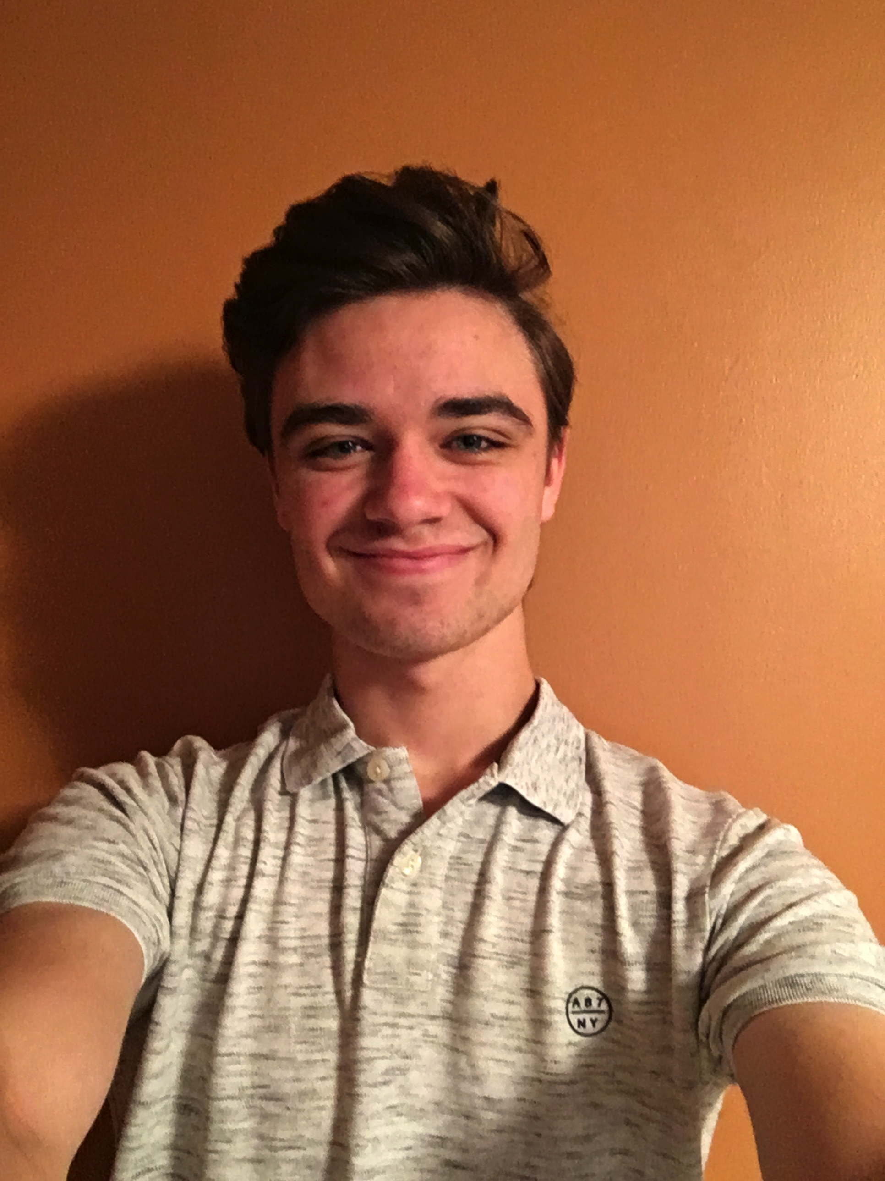
Introduction
Tony Cai
University of Minnesota
Kristen Hawken
Iowa State
Naren Nandyal
University of Minnesota
Mason Schmidt
Pensacola Christian College
Notes:
Standard Assets Engineering Operations
"We partner with Optum data producers and consumers, along with Enterprise Data Architects, to design and implement standard data stores that make the most critical Optum data available to all parts of the business in a common, well understood form.”

Slide 3


Background
Rally Health
V2 – Old way of constructing canonical streams
Limited support
Uses obsolete technologies
V3 – Current way of constructing canonical streams
Uses the capabilities of EBaaS (Entity Builder as a Service)
Takes advantage of modern technologies
Notes:
Tony
Rally Health provides reward programs for customers of uhg
Currently check eligibilities through v2 stream
old; has high risk and high cost from limited knowledge, support, and outdated technologies
EBaaS: “EBaaS is a tool to reliably denormalize and canonicalize large relational datasets in real time. EBaaS is a platform offering that provides fast, scalable resilient data streaming into the Health Care Platform at a significantly reduced cost than doing so independently.”
Canonical Data is beneficial because it allows data to be shared in the simplest form and allows for a common language to manage the data. It allows for smoother integration.
Kristen will go more in depth into why the v2 is a problem

Slide 4

Problem Statement
Why this is a problem:
High Risk – Knowledge and support is limited
High Cost – Depends on obsolete and expensive software and infrastructure
Lack of standardization
On September 9, 2022, Rally Health will be the last consumer of V2 streams
Rally Health currently receives eligibility data in the legacy V2 canonical stream.
Notes:
Kristen
As Tony said, Rally Health is currently using the legacy V2 canonical stream, and we want to shift them to the current standard V3 stream. This is because V2 is high risk, as there is limited knowledge and support for it. If there’s an outage, it could take a long time to fix it, or even notice that it’s happening. It’s also high cost as it depends out of date and costly software and infrastructure. They are soon to be the last consumer of V2 streams, but they are hesitant to change and cannot commit to switching until early 2023 So, we have to show them the benefits of converting and also create a smooth transition for them. This brings us to our solution

Slide 5
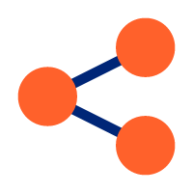


Solution
Using two different types of testing
Utilizing EBaaS to map the V3 canonical to the Rally canonical
Using testing to make sure the mapping is done correctly
Unit testing – for specific mapped values
Using the EBaaS test harness – for testing all the mapped values
V2
infrastructure decommissioned
greatly reduced
$250-300k
average savings each month
Risk
Notes:
Kristen
Rally will use the same schema, but will connect to our V3 stream instead of our V2 stream. This switch is only on our end, as their messages will still read in the same format on their end. This way we can transfer them over seamlessly.
Use EBaaS test harness and mapper to map v3 canonical to Rally canonical
Like any software, it requires testing tests that will tell us if our mapping is incorrect.
Unit testing to incrementally work through mapper logic, test harness to bring everything together
Save 250-300k a month, with no one left using it finally end and decommission V2 infrastructure, reduce risk

Slide 6



Tech Stack
GCP
To host Kubernetes
GoLang
To program
Kafka
To send/receive data from canonical streams
Docker
To ship the application
EBaaS
To join data, map, and produce a Kafka output topic
Kubernetes
To run on top of cloud
(Kafka)
Notes:
Naren
GoLang: the programming language we will use to implement and use EBaaS (entity builder as a service), allowing us to convert to V3 because V3 implements EBaaS.
Kafka: Kafka is an event-streaming platform, used for pipelining data. Kafka will be used to send and receive data from canonical streams
Docker: will be used to publish the application for transport and make it compatible across any system.
EBaaS: Inhouse tool to reliably denormalize and canonicalize large relational datasets in real time
Azure/GCP: We are going to be using the cloud platform, Google Cloud Platform, which we can use to host Kubernetes
Kubernetes: This is an open-source system for managing containers. So, this will run on top of cloud and allow us to manage our Docker containers
Now that we have an overview of our tech stack, Mason will dive into an overview of our project.

Slide 7
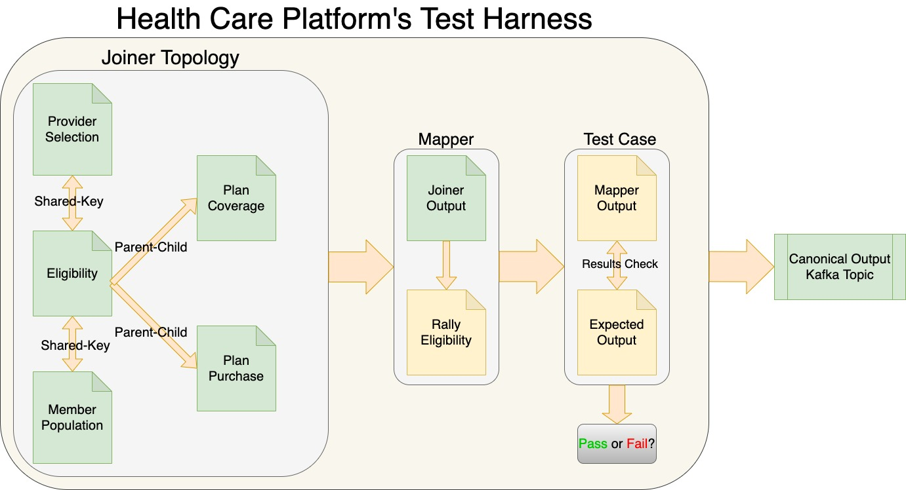
Project Overview
Notes:
Mason
First, we set up our joiner topology for all of our input canonicals.
The way they are joined together is by their keys.
Pulls most fields from the eligibility v3 canonical, but also takes other fields from separate canonicals
all necessary fields get mapped to rally canonical format
With mapping we created unit tests to make sure the values matched
When we were working on testing, we only added fields in the canonicals that we needed to map. However, we went back and decided to add in all the fields. This will make it easier for people in the future who want to consume from these canonicals. Because then they would already have test data to use, and they wouldn’t have to fill it in themselves.
Then we made test cases to make sure that our joiner and our mapper was configured correctly. We check to make sure that our mapper output is what we expect by comparing it to our expected output. We then get a pass or fail depending on if our mapper output matched our expected output or not.
Finally, we deploy our project to get a kafka topic that can be accessed by Rally Health

Slide 8
Completed Test Harness Video
Notes:
Mason
Here we have the joiner topology that we talked about in the last slide. We are currently using 4 different topology steps. Then you can see that we ran the test from our configuration folder and got a pass. So that means that all of the mapping that was done was done correctly according to the expected output that we have in the test.

Slide 9
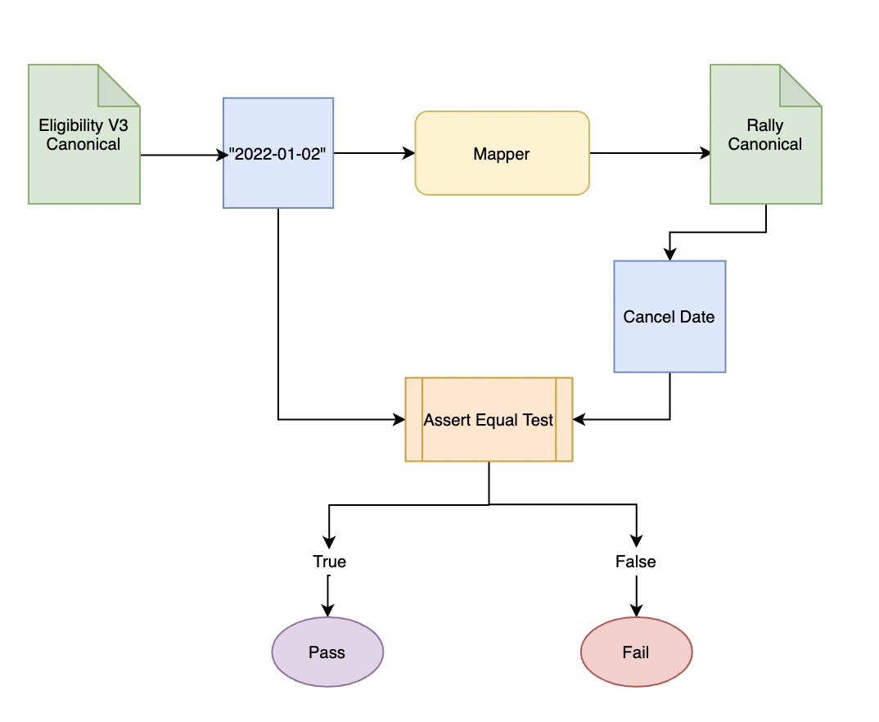
Specific unit test example
Notes:
Naren
In order to confirm that our mapping was done correctly, we created numerous unit tests for each of the fields that we mapped.
To give a sample of how a unit test work, this diagram shows the testing of the “cancelDate” field
-we first found the date that was assigned to the cancelDate field in our eligibility input canonical.
-Then we mapped this whole input canonical to the Rally canonical.
-Then, in our unit testing, we used an Assert Equal test to compare the cancel Date value we had noted down from our input with the cancelDate field in the Rally Health Canonical.
-If these fields matched, the assert equal test would return true and the test passed.

Slide 10
Completed Unit Testing Video
Notes:
Naren
-We now have a demo of our unit tests for all our mapped values
-You can see all the fields have their own assert equals with the specific value from the input canonical compared to the corresponding fields in the rally health canonical.
-The output shows all the fields and that they pass
-One thing to keep in mind: there could be edge cases that we did not account for
-This is NOT the code for the mapping, which we also did, but just the testing for the mapping

Slide 11


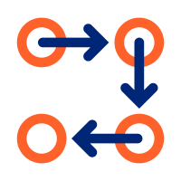
Hand-off Plan
Deploy non-prod mapper
Setup prod topics
Pass these onto the rest of the SAEO team, who will work will Rally Health to deploy the mapper into production
Notes:
Tony
We have set up nonprod/prod kafka topics and have deployed the non prod mapper,
Pass along our knowledge in the coming days about our work so that the SAEO team only needs to work with Rally Health to deploy the mapper for Rally to use and maintain the topics

Slide 12

What We've Learned
Notes:
Tony: Learning all the scrum and agile methodologies to foster teamwork in the workplace, as well as learning and creating solutions without much guidance
Kristen: Being thrown into a totally new position with new technology, I learned how to work with and rely on my teammates to overcome a steep learning curve.
Naren: I learned how to problem solve and apply previous knowledge to new tasks while being introduced to new technologies and softwares.
Mason: I learned how to manage and split up work within our team, and also learned how to communicate with each other to get our project done.

Slide 13
Kafka Logo: https://commons.wikimedia.org/wiki/File:Apache_kafka-icon.svg
GoLang Logo: https://en.wikipedia.org/wiki/Go_%28programming_language%29
Docker Logo: https://www.docker.com/company/newsroom/media-resources/

